Slide 1
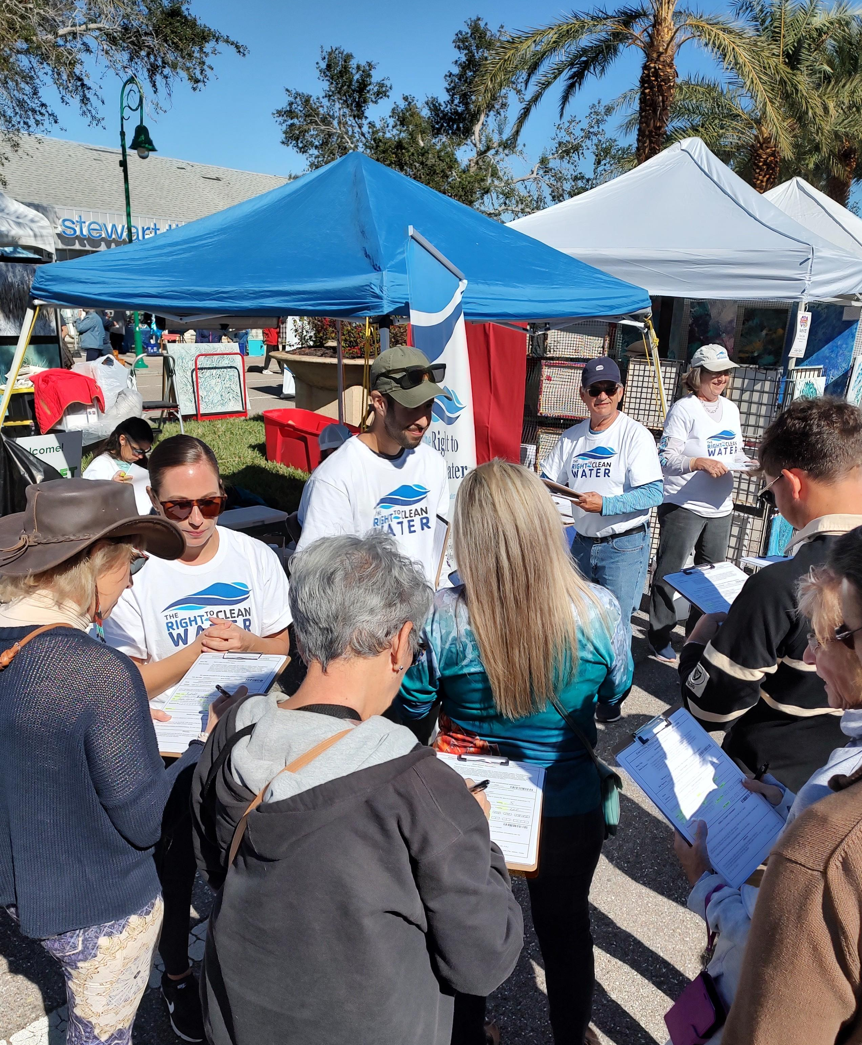
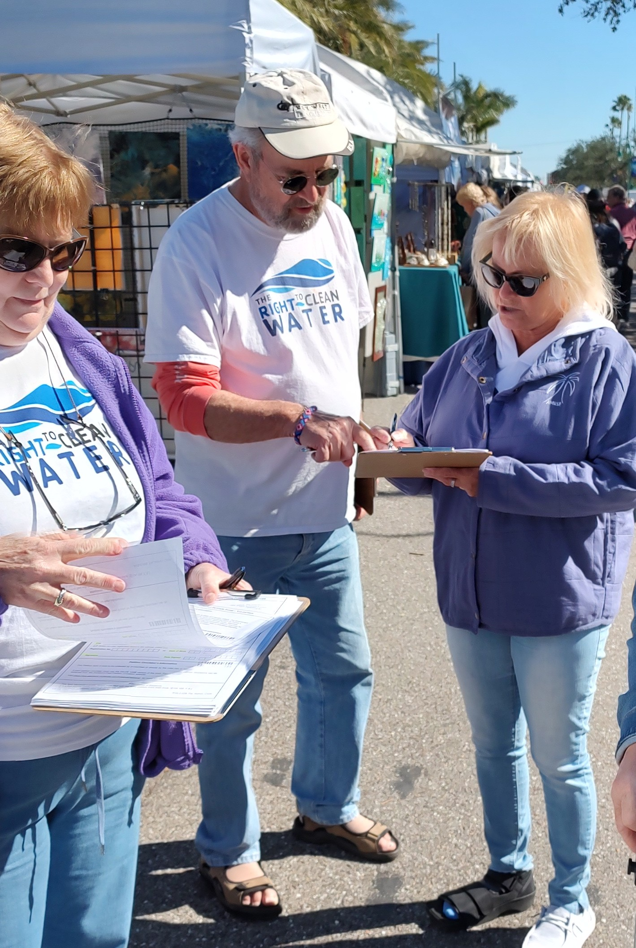
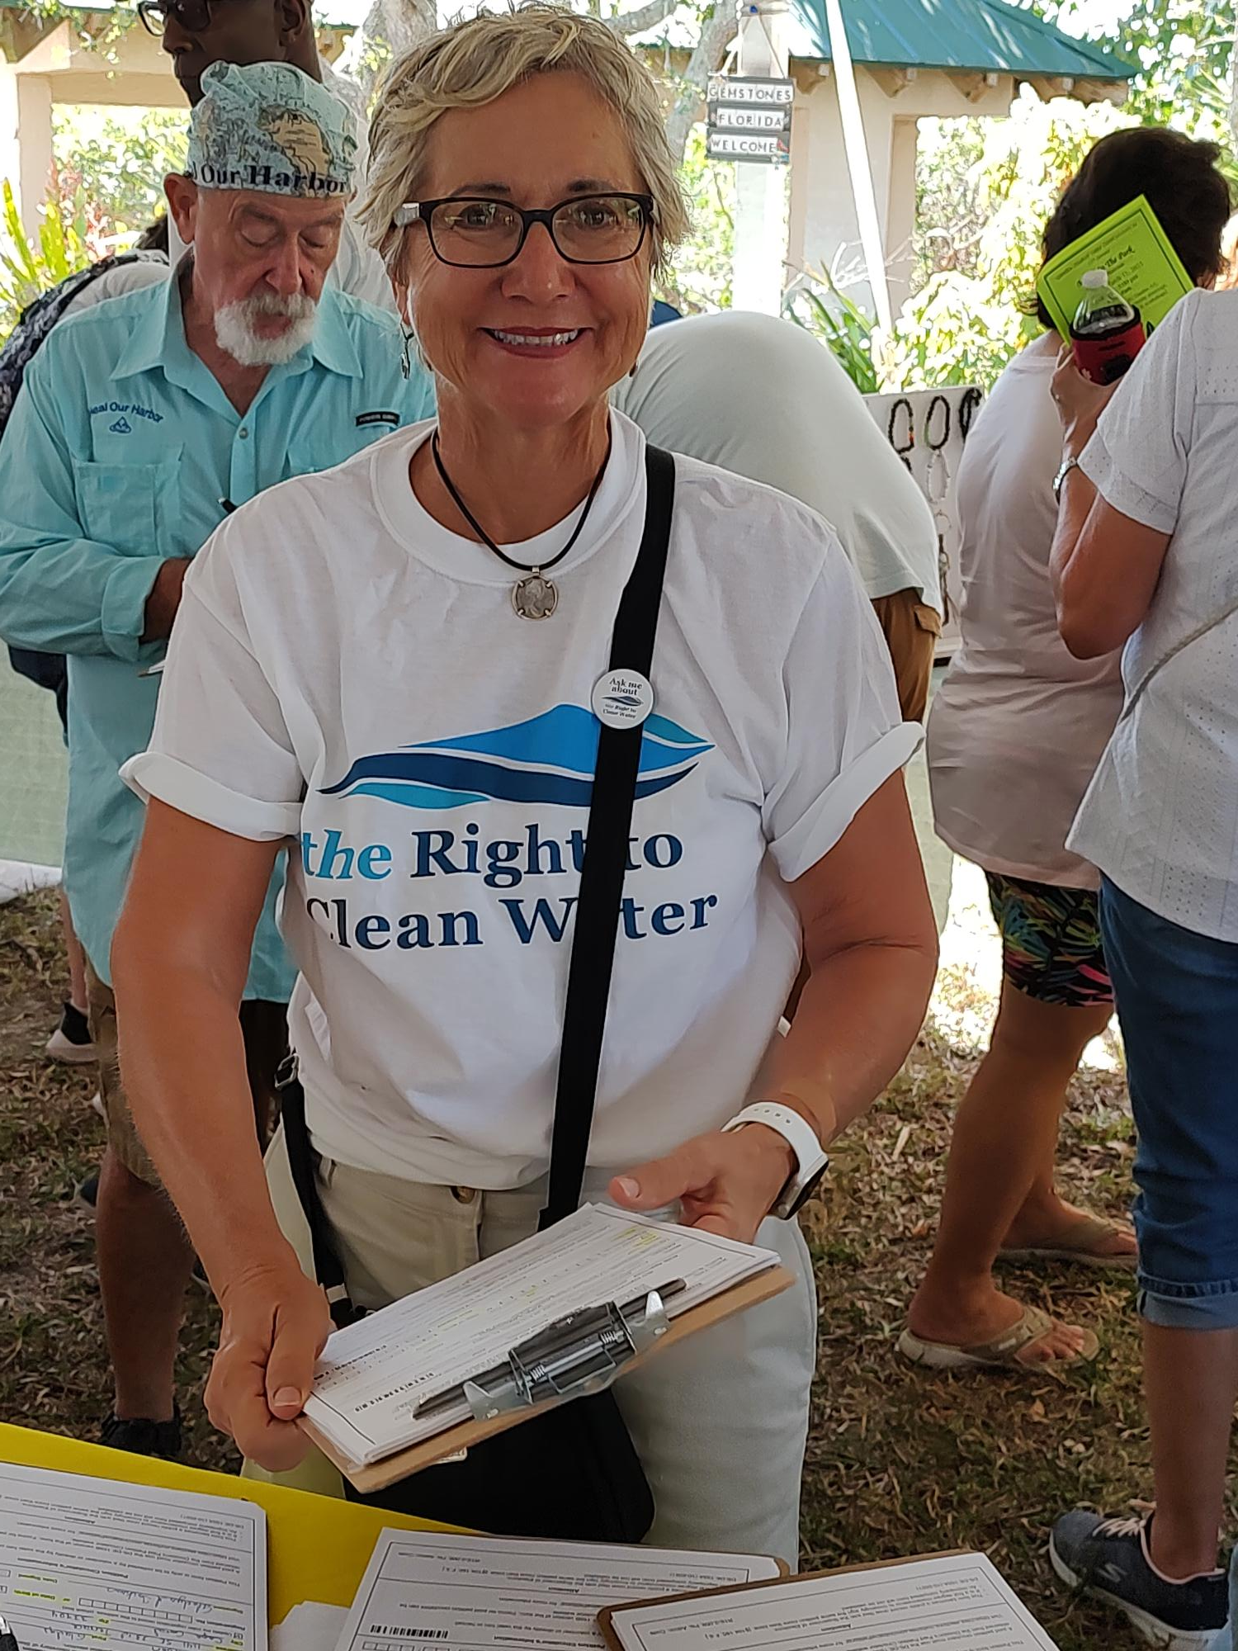

The Right to
Clean and Healthy
Waters
Constitutional Amendment
A Citizens’ Initiative
FloridaRightToCleanWater.org

Slide 2
The Right to
Clean and Healthy
Waters…
Because the system isn’t working.
Notes:
Hi everyone. I’m Joseph Bonasia, Communications Director
I’m here to talk about the RTCHW Citizens’ Initiative
We need this fundamental right because of environmental regulatory system isn’t working

Slide 3
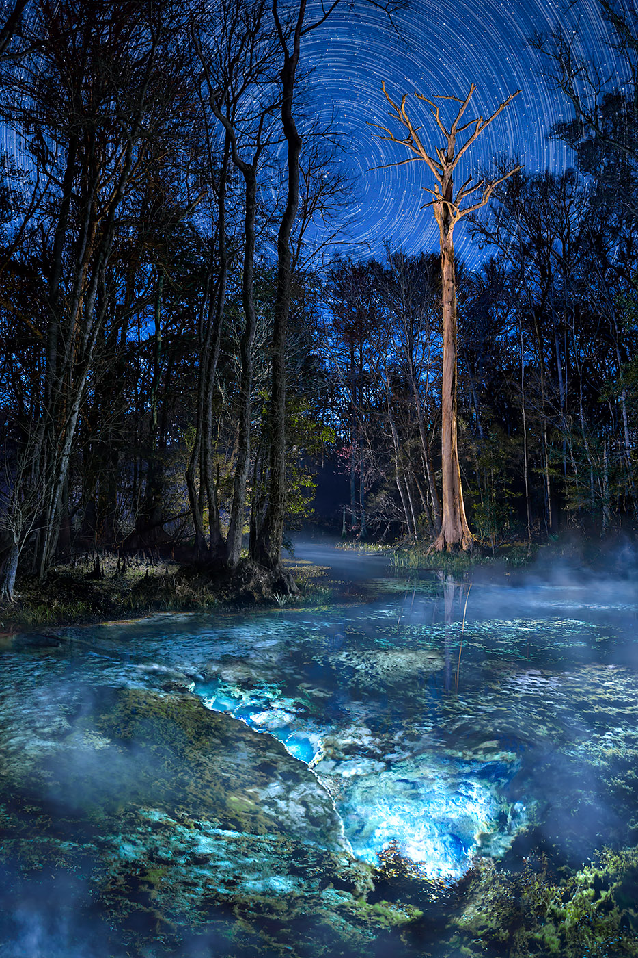
Photos: John Moran
Notes:
We have approximately 1,000 springs in Florida, ecological gems

Slide 4

80 percent of Florida’s over 1,000 artesian springs are polluted by excessive nitrogen concentrations.
Flows in Florida’s springs and spring-fed rivers have declined by more than one-third. (Florida Springs Council)
John Moran
Notes:
Reputable sources

Slide 5
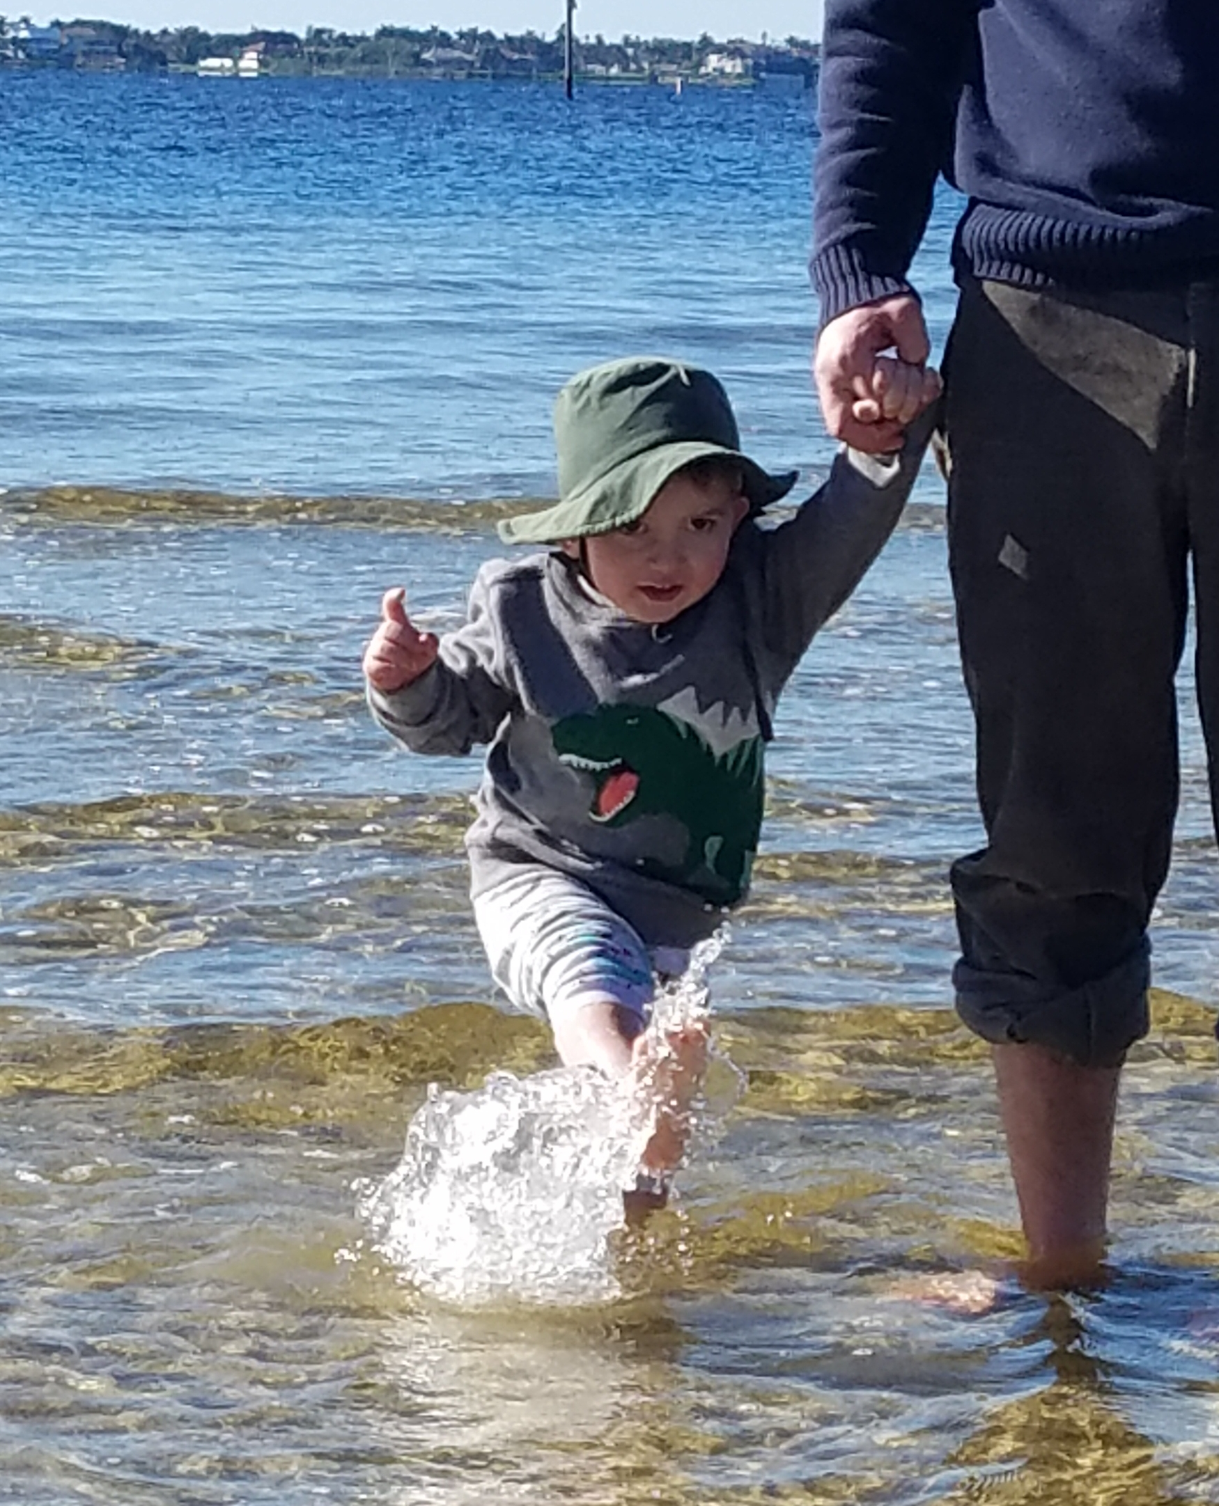
There are nearly a million acres of estuaries and 9,000 miles of streams and rivers designated for recreation that are impaired with fecal bacteria. (Calusa Waterkeeper)

Slide 6
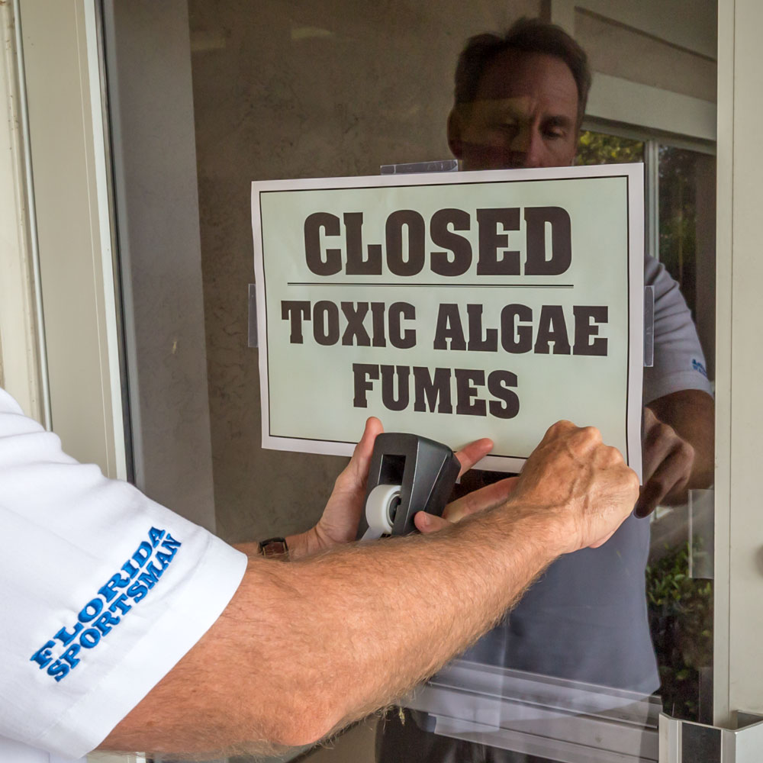
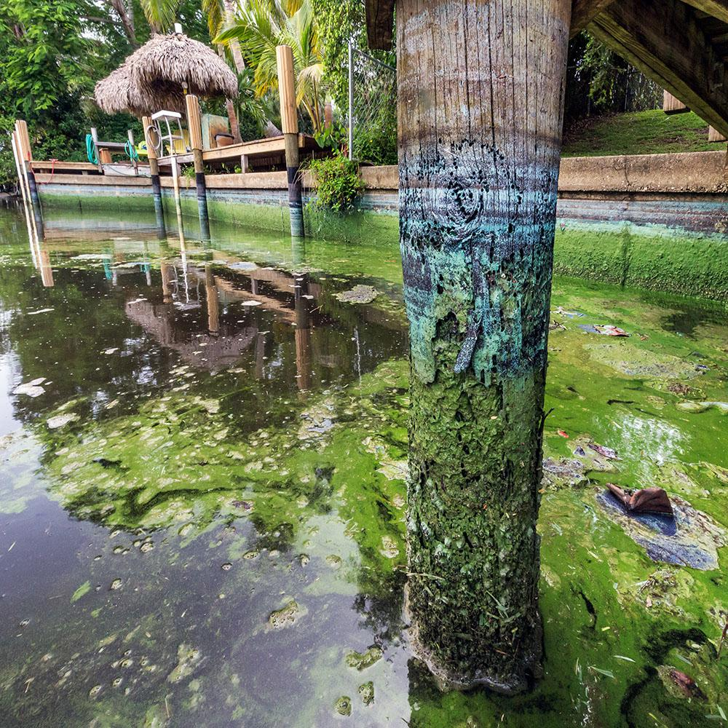
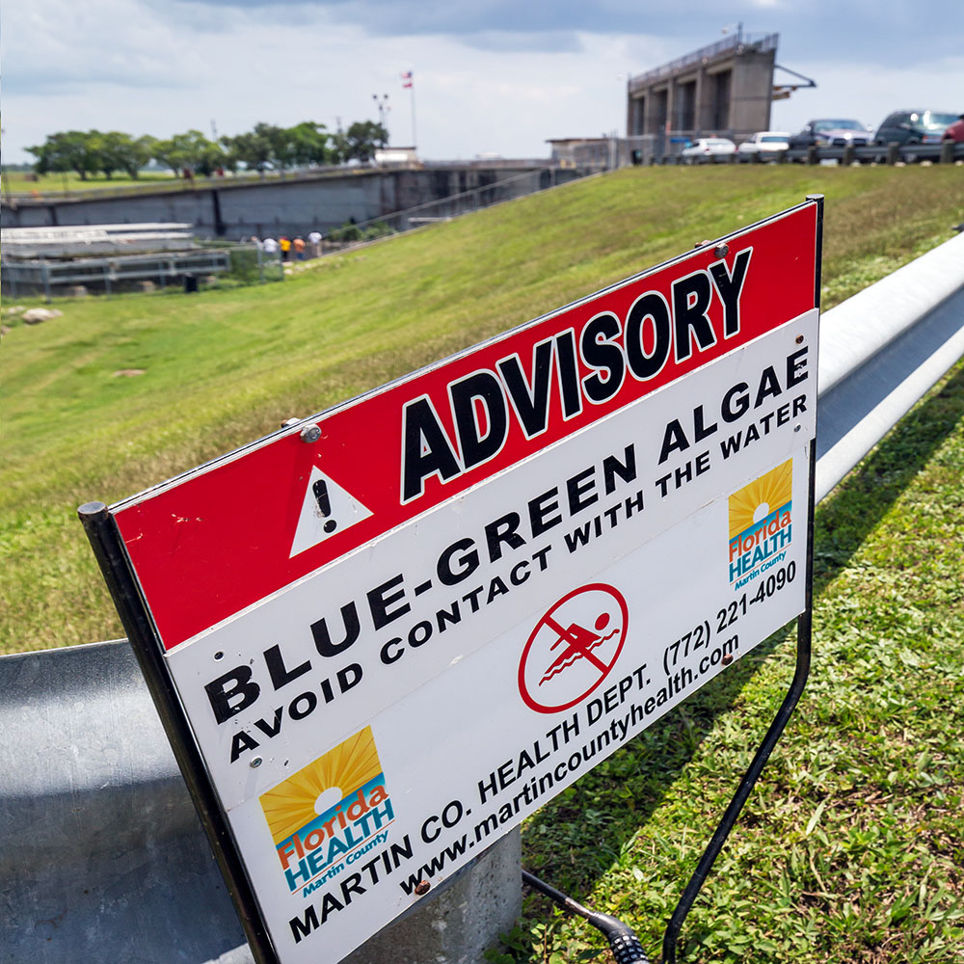
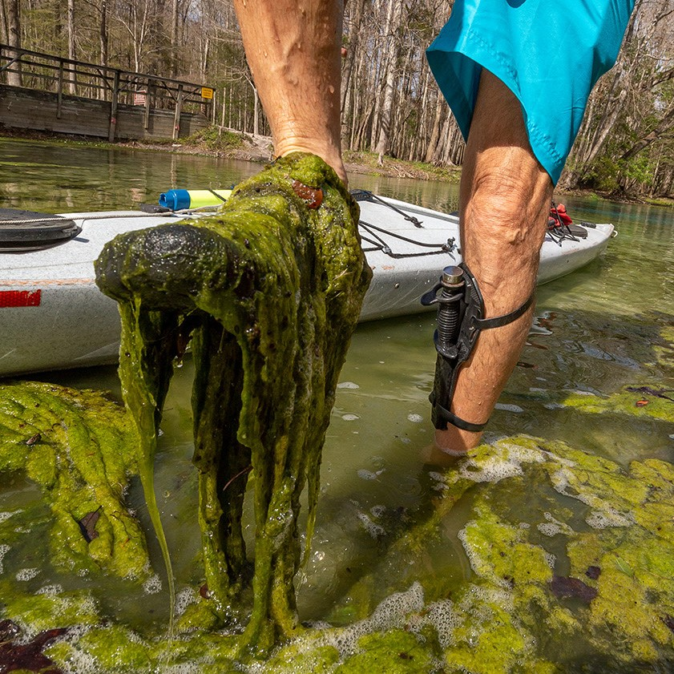
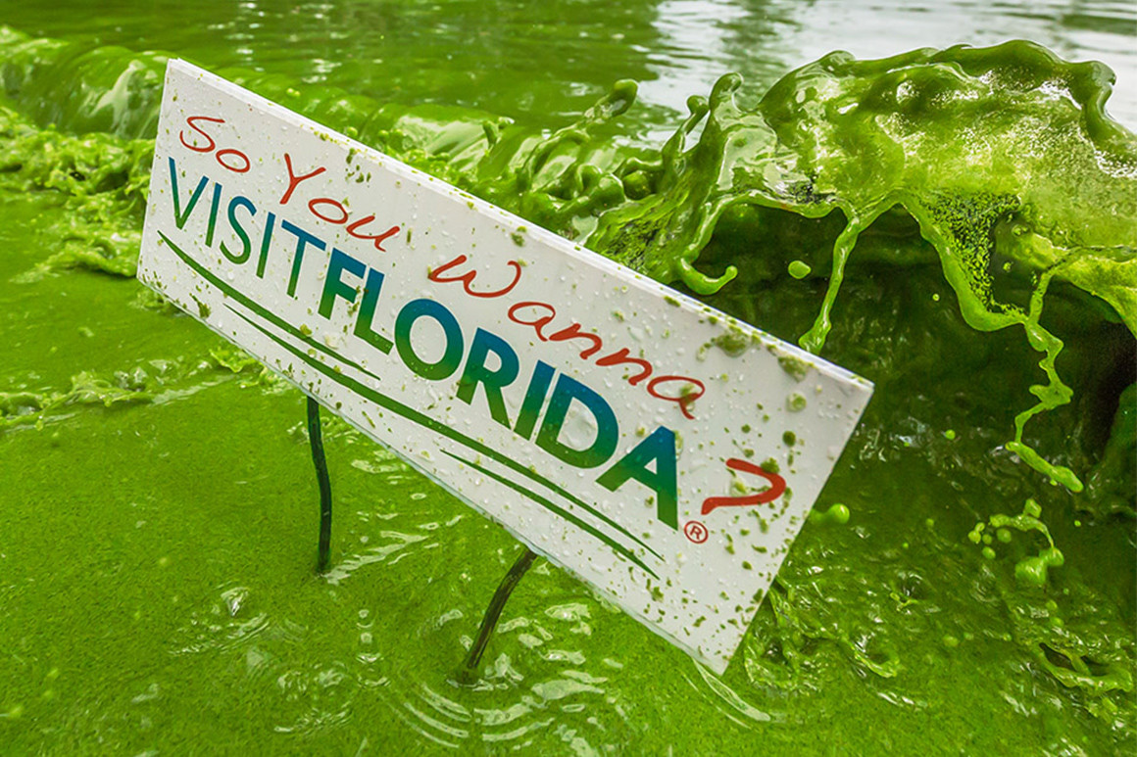
50,000 tons of legacy phosphorus sit at the bottom of Lake Okeechobee feeding blue-green algae blooms.
John Moran
Notes:
Feeding ugly blue-green algae blooms in the lake, rivers and canals in South Florida
They make people sick. They are linked to neurodegenerative diseases like Parkinson’s and Alzheimer’s
And they suffocate marine life and hurt local tourists economies.

Slide 7
During the past fifty years, the state has issued 23,000 National Pollutant Discharge Elimination Permits (10% of nation’s total) to allow industry and agriculture to discharge pollution into the surface waters of the state. A Toxic Inconvenience. Nicholas Penniman
John Moran
Notes:
Toxic Inconvenience

Slide 8
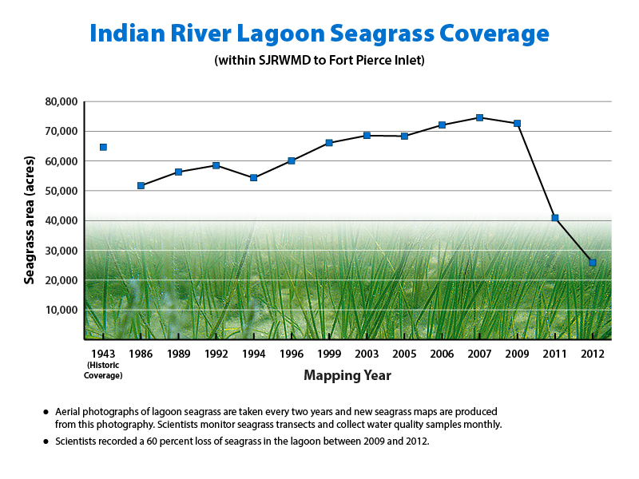
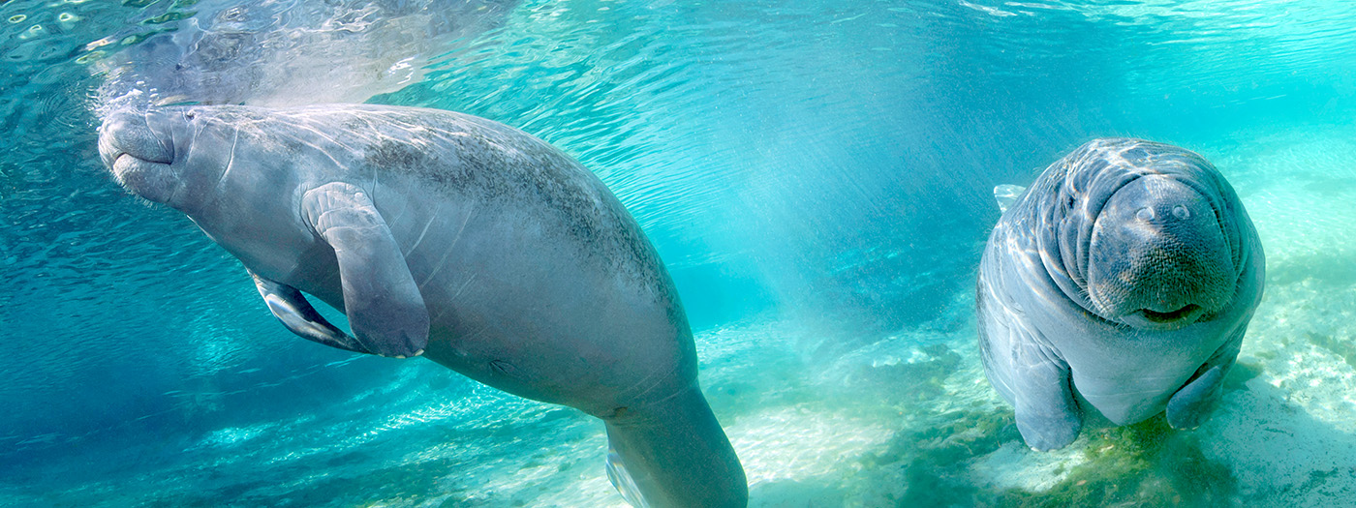
The IRL Council and Indian River Lagoon National Estuary Program / 2020
Notes:
Death spiral
IRL 58,000 acres lost since 2009, but happening elsewhere, too

Slide 9
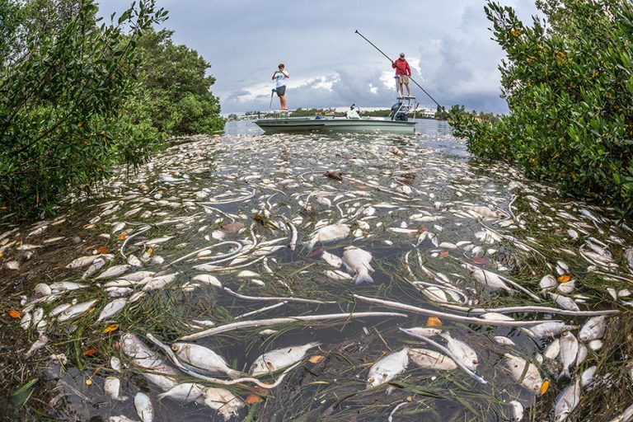
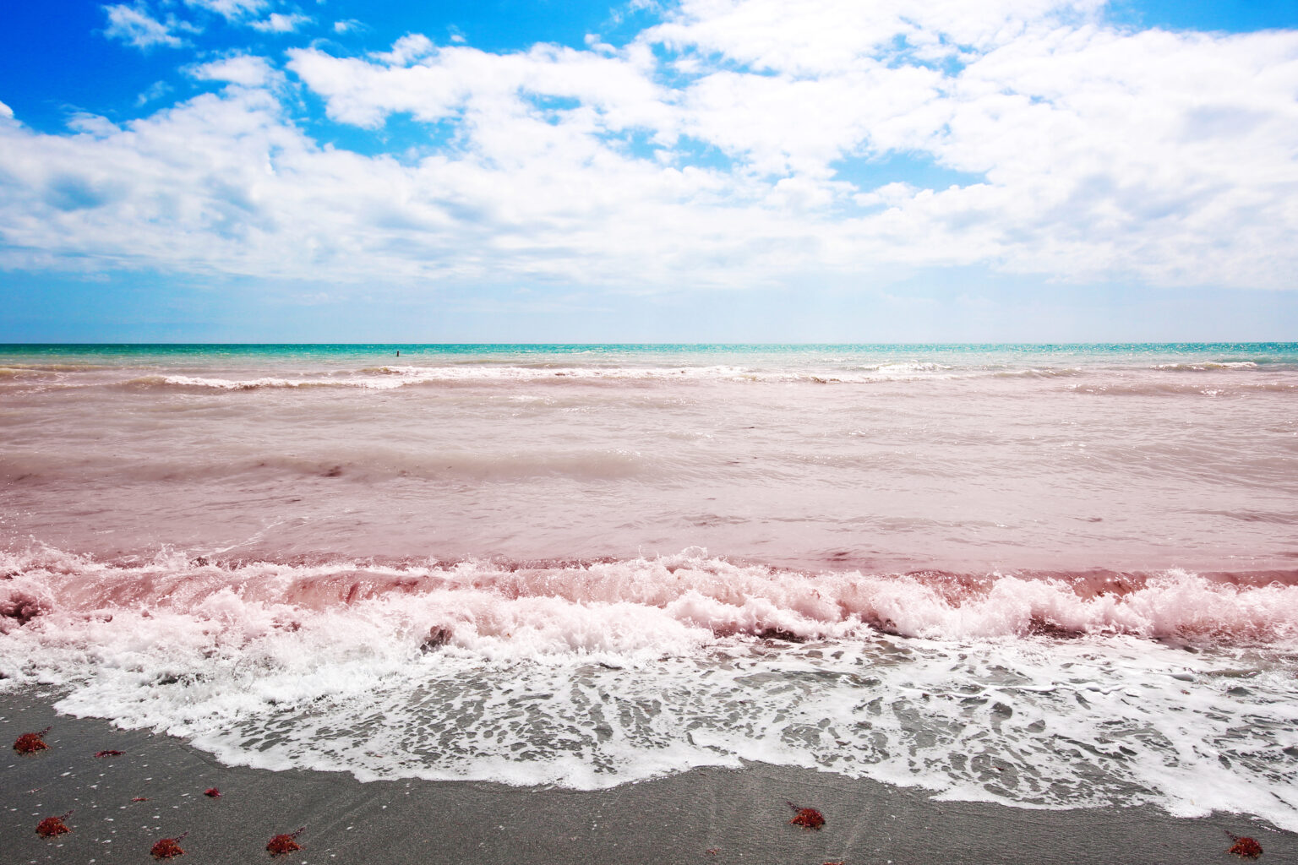
Whereas from 1878 to 1994 there were 64 months of red tide, during the past 27 years, there have been over 200 months of red tide.
(A Toxic Inconvenience)
Red tide s shown at a Florida beach in this file photo. Credit: GettyImages
Notes:
Red tide in Florida is again making national news

Slide 10
No state has more polluted lake water than does Florida.
No state has lost more acres of wetlands
than has Florida: 9.3 million.

Slide 11
Why isn’t the system working?
Notes:
To a large extent, because special interests have undue influence over our state legislature and thus environmental policy
They get laws passed that benefit them at the cost of the public and the health of our waters.
“There are better ways [than a constitutional amendment] to tackle the serious environmental issues raised by FRCW: through the carefully crafted regulations by appropriate State executive agencies, where the science, commonsense, and lots of deliberations by dedicated staff hold sway.”

Slide 12
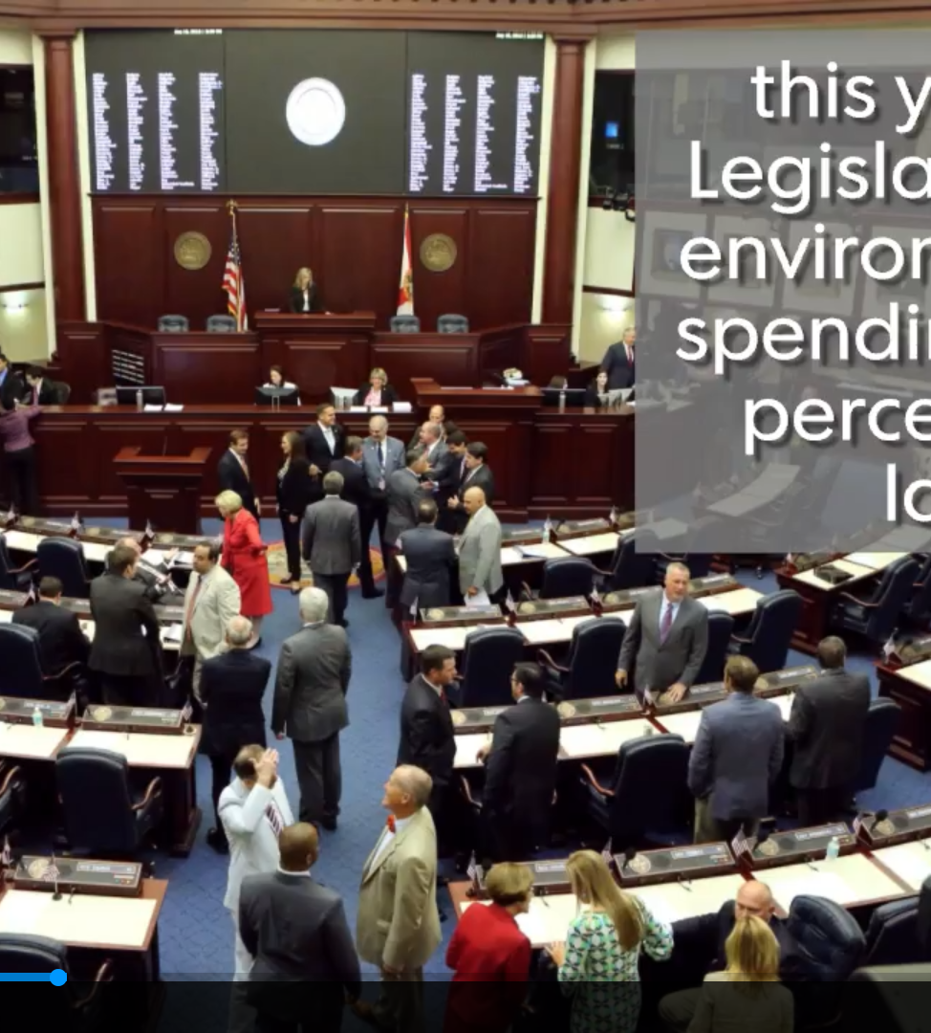
Special interests have
undue influence over elected officials and thus
over environmental policy
TC Palm

Slide 13
South Florida Water Management
District emails show U.S. Sugar Corp.
lobbyist's influence
TC Palm Aug 6, 2018
https://www.tcpalm.com/story/news/investigations/2017/08/30/u-s-sugar-lobbyist-influence-over-florida-water-pollution-rules/464671001/

Slide 14
“South Florida water managers were on the verge of an agricultural pollution crackdown when they scrapped their plans and let a sugar lobbyist dictate edits to a 2015 annual report that paved the way for weaker regulations [resulting in ] a plan that takes polluters at their word and holds no one accountable if water quality suffers.”

Slide 15
“The sugar lobbyist's influence, which exceeded that of scientists, environmentalists and the general public, affected changes to rules meant to protect Florida waterways from pollutants that feed toxic algae blooms. ”
Notes:
$11million in 2020; 54 lobbyists
This is just flat out wrong, isn’t it?
But this is what happens.

Slide 16
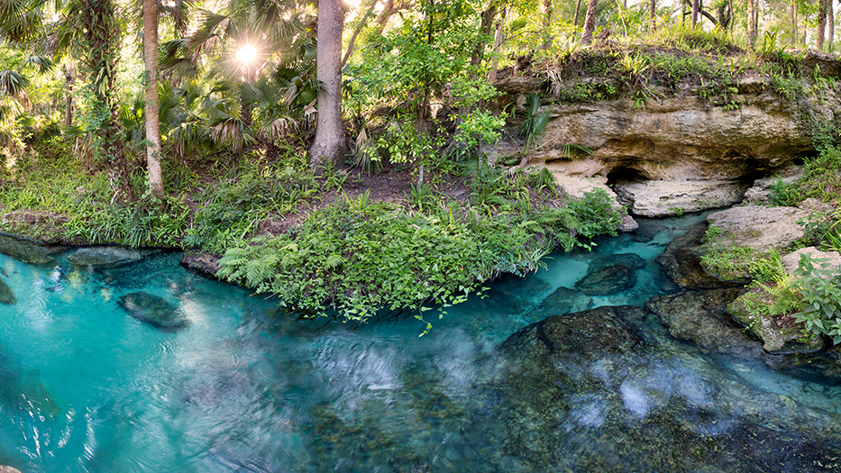
Orange County
Right to Clean Water Charter Amendment approved by 89% of voters
Granted all waterways “the right to exist, flow, be free of Pollution, and to maintain a healthy ecosystem.”
Granted citizens “a right to clean water.”
John Moran
Notes:
Orange county voters: no faith in system, tired of polluted water, passed this amendment

Slide 17
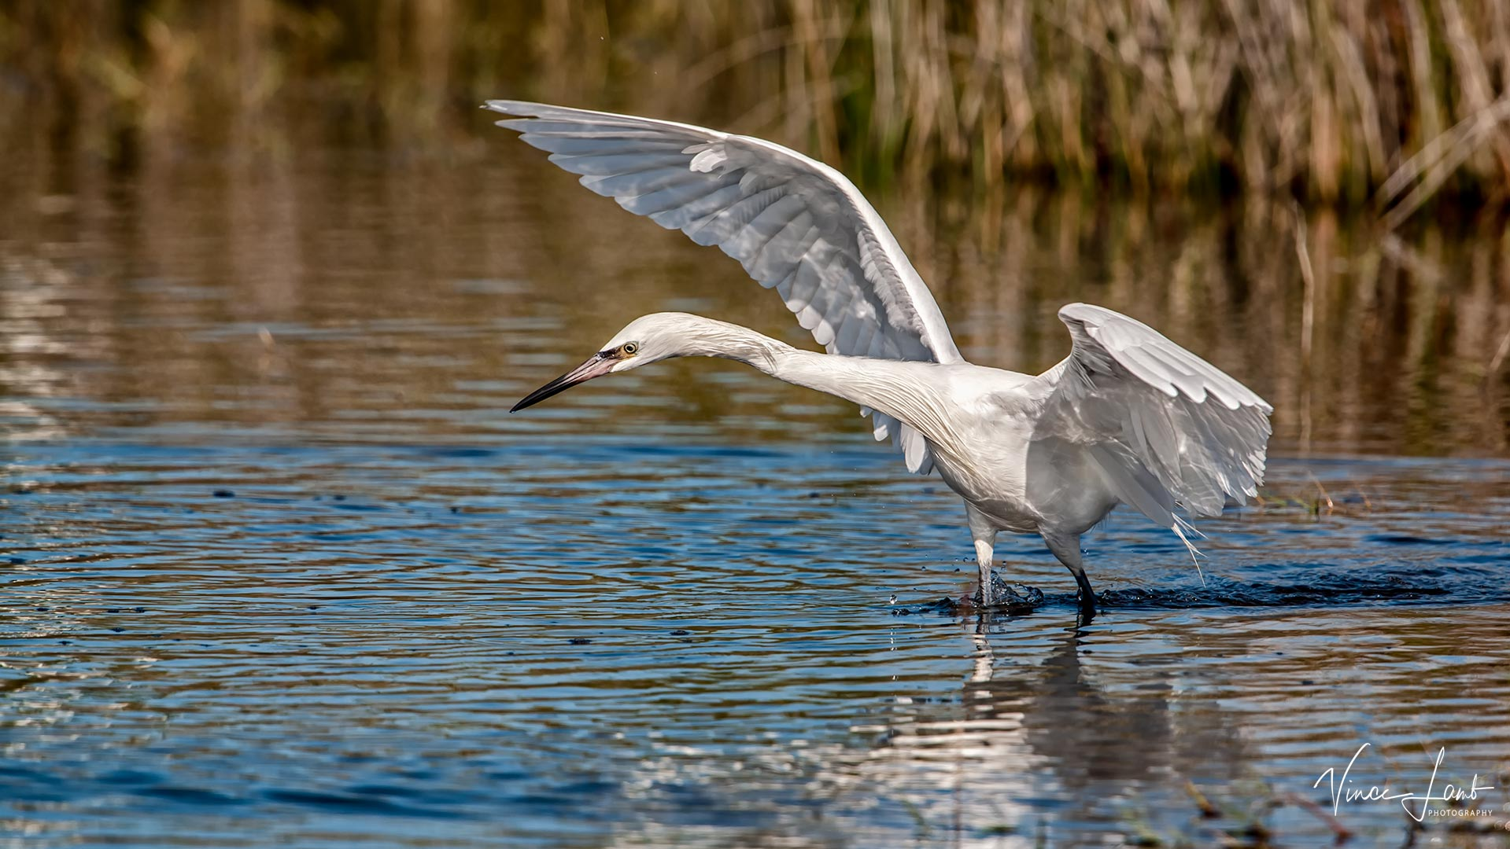
One citizen sued a developer and the FDEP to stop the destruction of wetlands in Orange County.
Court dismissed the lawsuit.
Notes:
Development will destroy 115 acres of wetlands.
Plaintiffs included bodies of water

Slide 18
State Preemption of local authority regarding nature.
Notes:
Snuffed out similar local initiatives
Protecting special interests
Developer; Farm Bureau…

Slide 19
A local government regulation, ordinance, code, rule, comprehensive plan, charter, or any other provision of law may not recognize or grant any legal rights to a plant, an animal, a body of water, or any other part of the natural environment that is not a person or political subdivision as defined in s. 1.01 or grant such person or political subdivision any specific rights relating to the natural environment not otherwise authorized in general law or specifically granted in the State Constitution.
2020 Clean Waterways Act
Notes:
Why would the legislature do this if not to protect special interests?
Sponsor was a developer; legislator of the year because of this preemption
Isn’t this wrong?

Slide 20
Blue-Green Algae Task Force
Recommendations implemented:
13%
Notes:
Sound science directing sound action…nope
Not just a problem in Florida.
I want to tell you about what happened in PA in 2012

Slide 21
What is the solution?
How do we correct the system?
John Moran
Notes:
Reputable sources

Slide 22
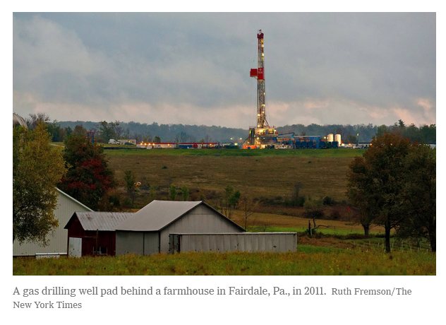

Act 13
Notes:
Written by fracking industry

Slide 23
“The people have the right to clean air, pure water, and to the preservation of the natural, scenic, historic, and aesthetic values of the environment.”
Pennsylvania Environmental Rights Amendment, 1972
Notes:
162-page court decision detailing history of env degradation in PA

Slide 24
“It is not a historic accident that the Pennsylvania Constitution now places citizens’ environmental rights on par with their political rights.”
Pennsylvania Supreme Court
Notes:
162-page court decision detailing history of env degradation in PA

Slide 25
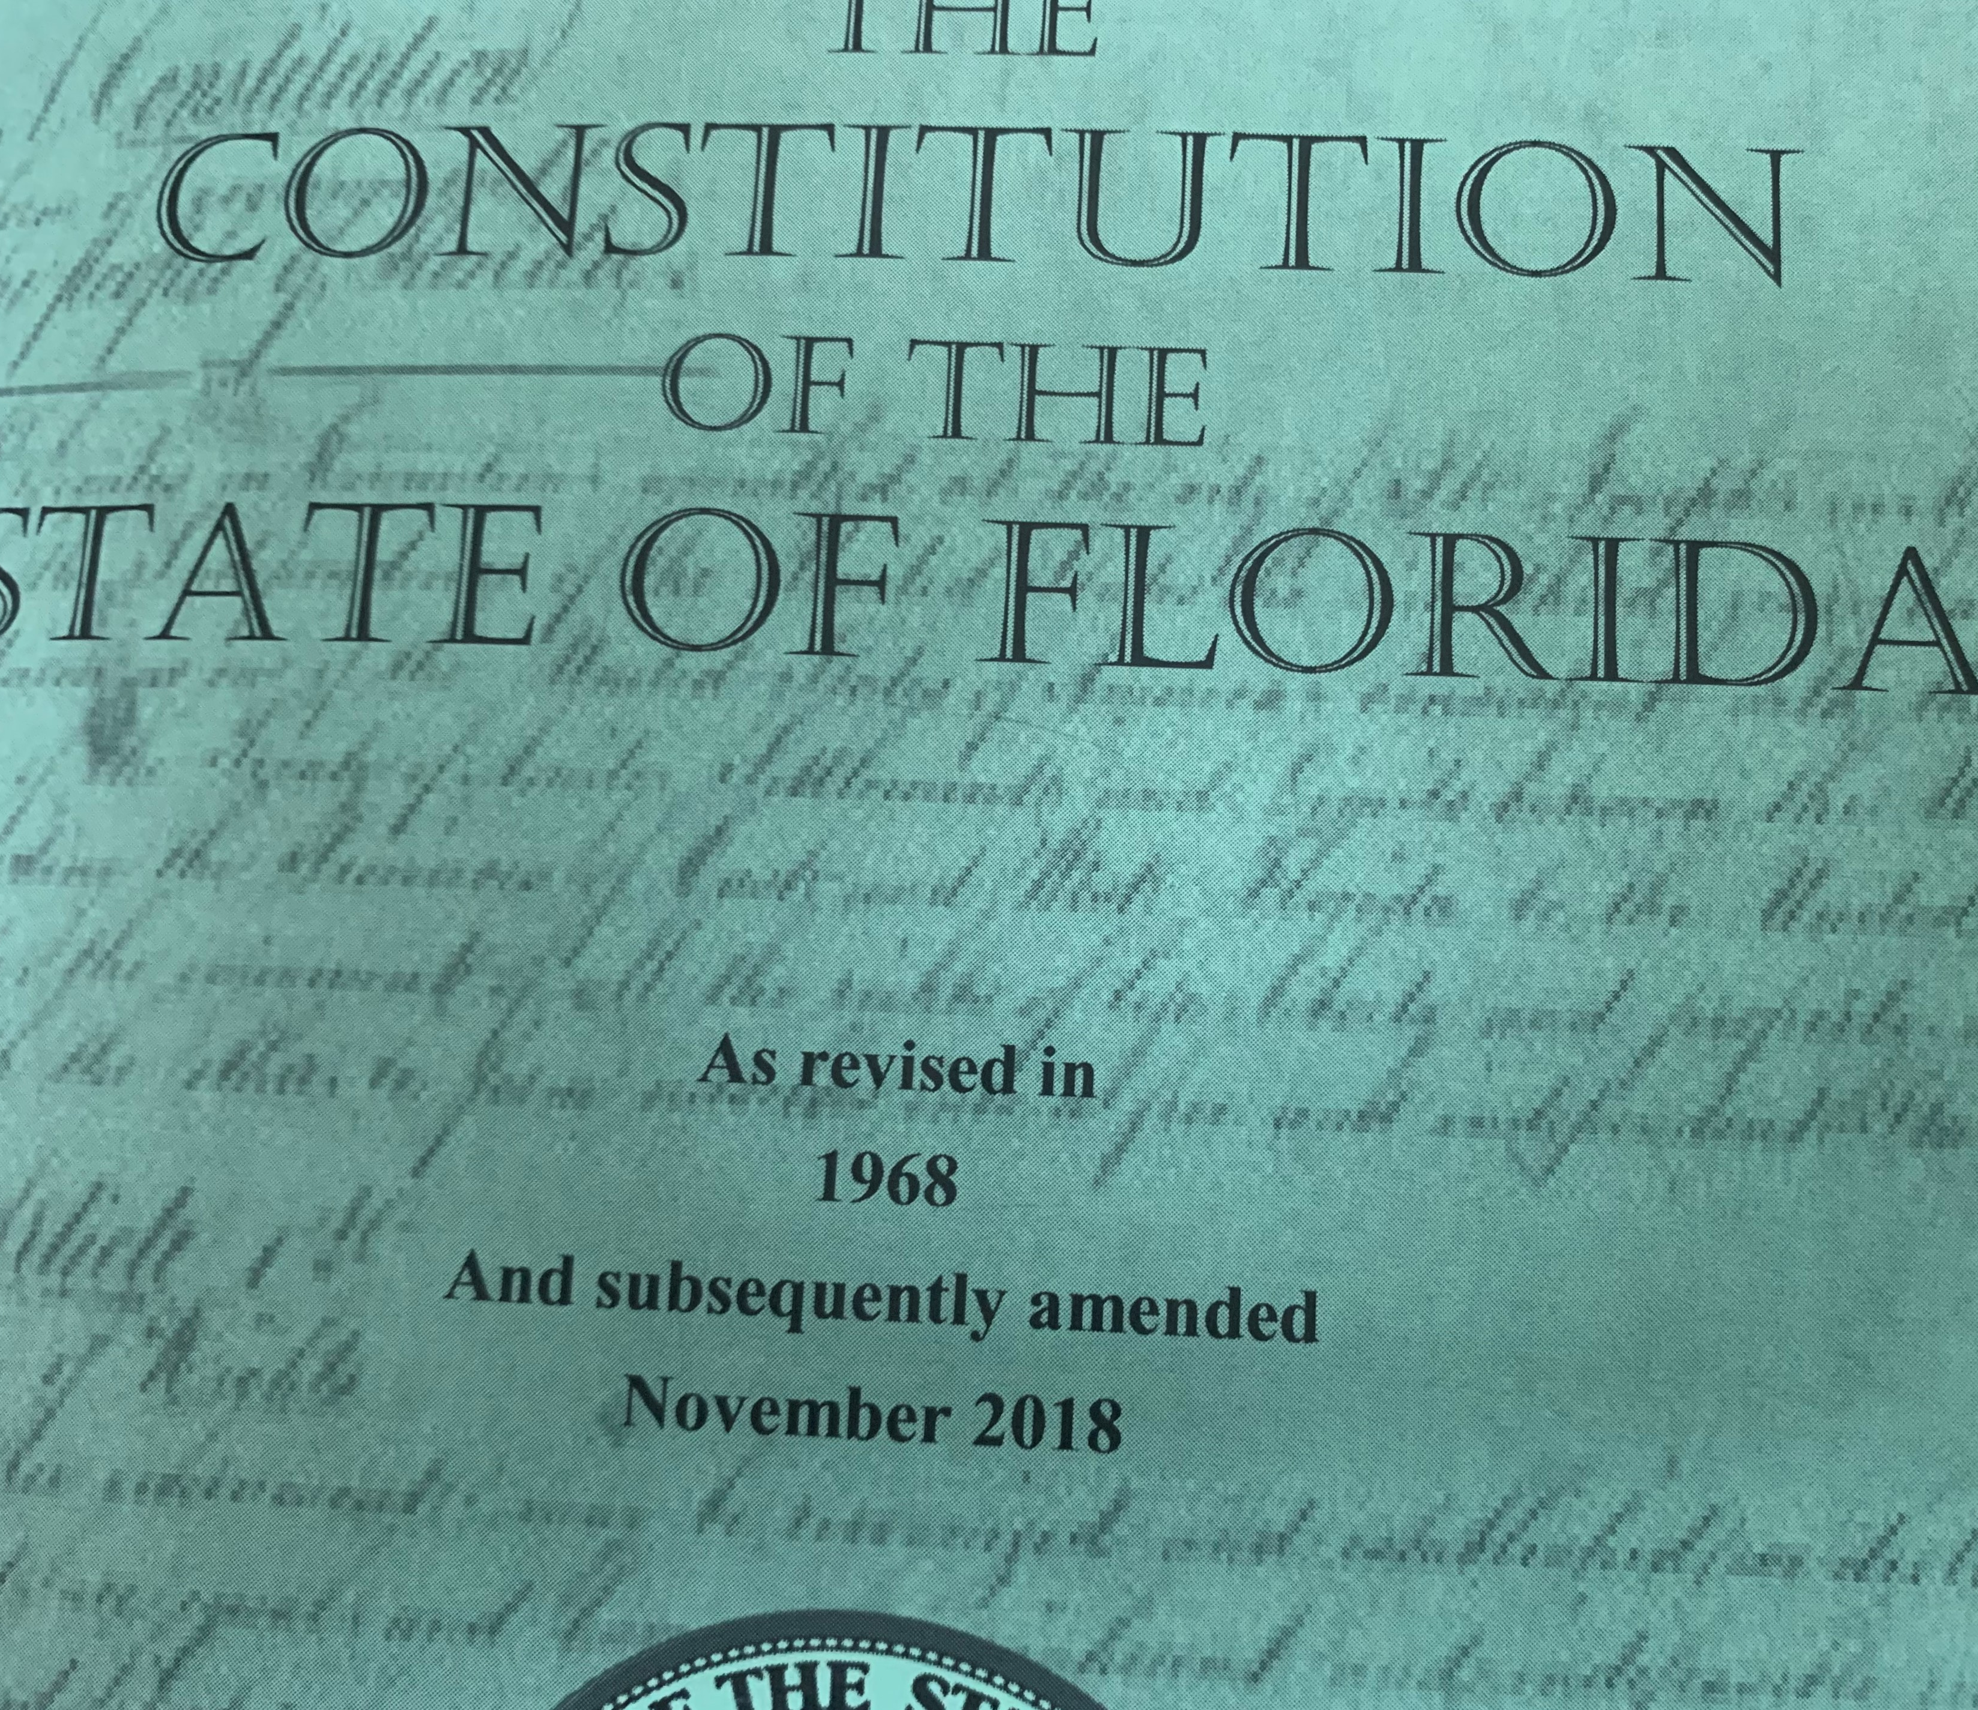
SECTION 7. Natural resources and scenic beauty.—(a) It shall be the policy of the state to conserve and protect its natural resources and scenic beauty. Adequate provision shall be made by law for the abatement of air and water pollution and of excessive and unnecessary noise and for the conservation and protection of natural resources.
Notes:
Special interests influence policy
Political ideologies
Legalize harm
We need more than policy. We need explicitly stated fundamental env rights

Slide 26
The Right to
Clean and Healthy
Waters
Constitutional Amendment
A Citizens’ Initiative

Slide 27
Ballot Summary:
This amendment creates a fundamental right to clean and healthy waters. The amendment may be used to sue State executive agencies for harm or threatened harm to Florida’s waters, which include aquatic ecosystems.
This amendment defines terms, identifies affected constitutional provisions in Article IV governing the executive branch, provides for civil action enforcement, allows attorney’s and expert witness fees to prevailing plaintiffs, and provides equitable remedies including restoration of waters.
John Moran
Notes:
Key word: fundamental

Slide 28
(b) DECLARATION OF RIGHT. The people have the inherent political power pursuant to Article I, Section 1 of this Constitution to create the fundamental right to clean and healthy waters. The people hereby declare this fundamental right, which is indefeasible.
SECTION 1. Political power.—All political power is inherent in the people.
Notes:
We have the power to create this right
Indefeasible means…

Slide 29
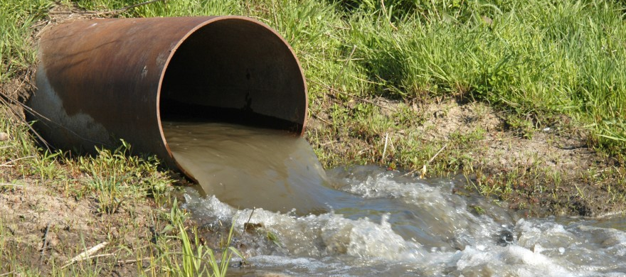
(c) HARM PROHIBITED. It shall be unlawful, and considered a violation of the right to clean
and healthy waters, for a State executive agency, as defined herein, to harm or threaten to harm Florida waters by action or inaction, including by regulation, rule, policy, plan, standard, permit, practice including management practice, activity, agreement…
Notes:
The state harms our waters and aquatic ecosystems directly through its actions and inaction.
A few examples

Slide 30
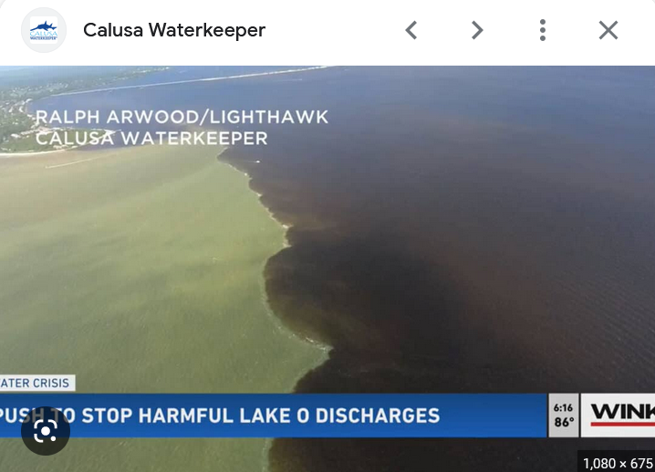
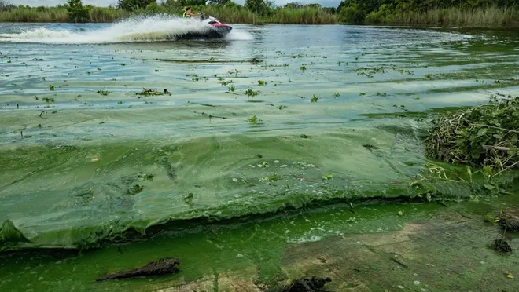
Palm Beach Post
Notes:
32 water basins not meeting water quality standards
Enforcement, monitoring, methods of evaluating
We could hold the DEP accountable
Stop pollution at the source

Slide 31
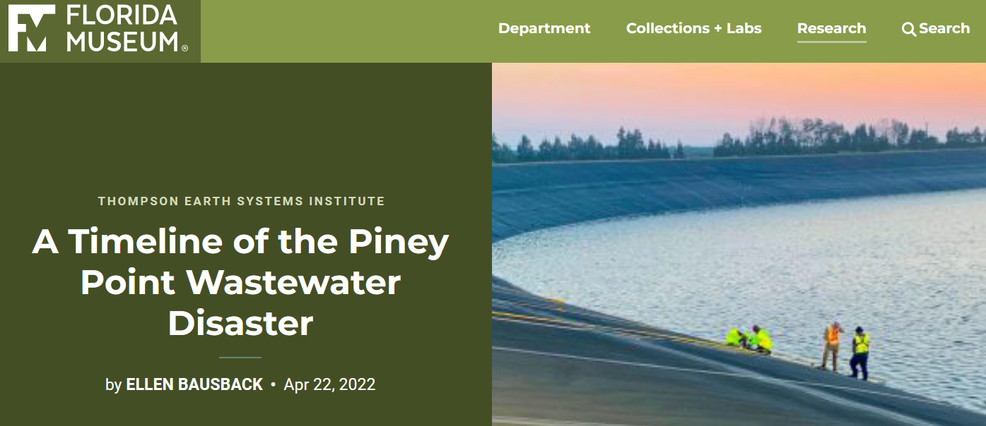
215 million gallons of polluted wastewater into Tampa Bay
Notes:
2008 Army Corp report
This is how science would dictate what should happen

Slide 32
The IRL Council and Indian River Lagoon National Estuary Program / 2020
Notes:
Water that can’t sustain seagrass is unhealthy

Slide 33
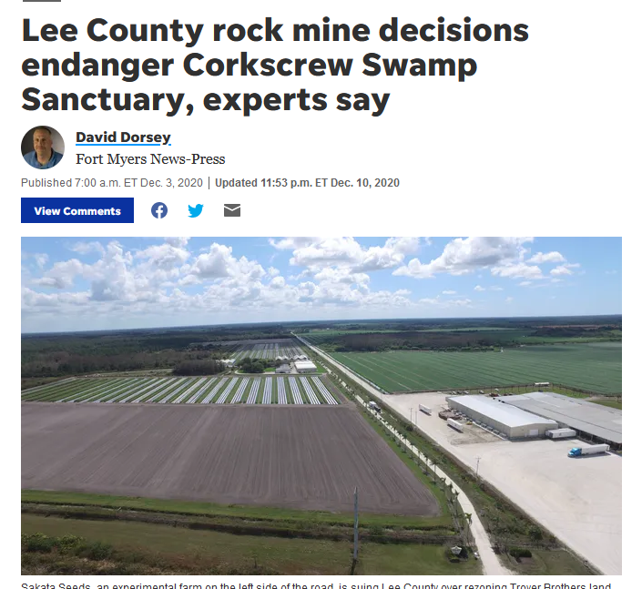
John Moran
Notes:
Used to have to prove there was a need for mining project
Lee County Commission got rid of that requirement
Got rid of Map 14
Ignored the finding of a 2-year million-dollar study
How do you draw a line and say “No more destroying wetlands!”?

Slide 34
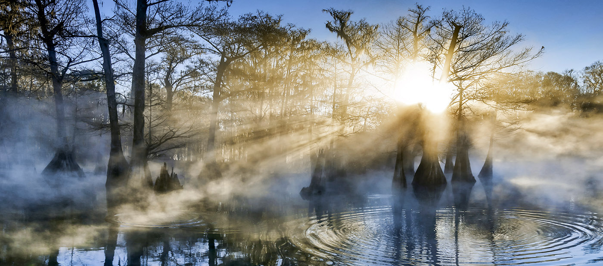
John Moran

Slide 35
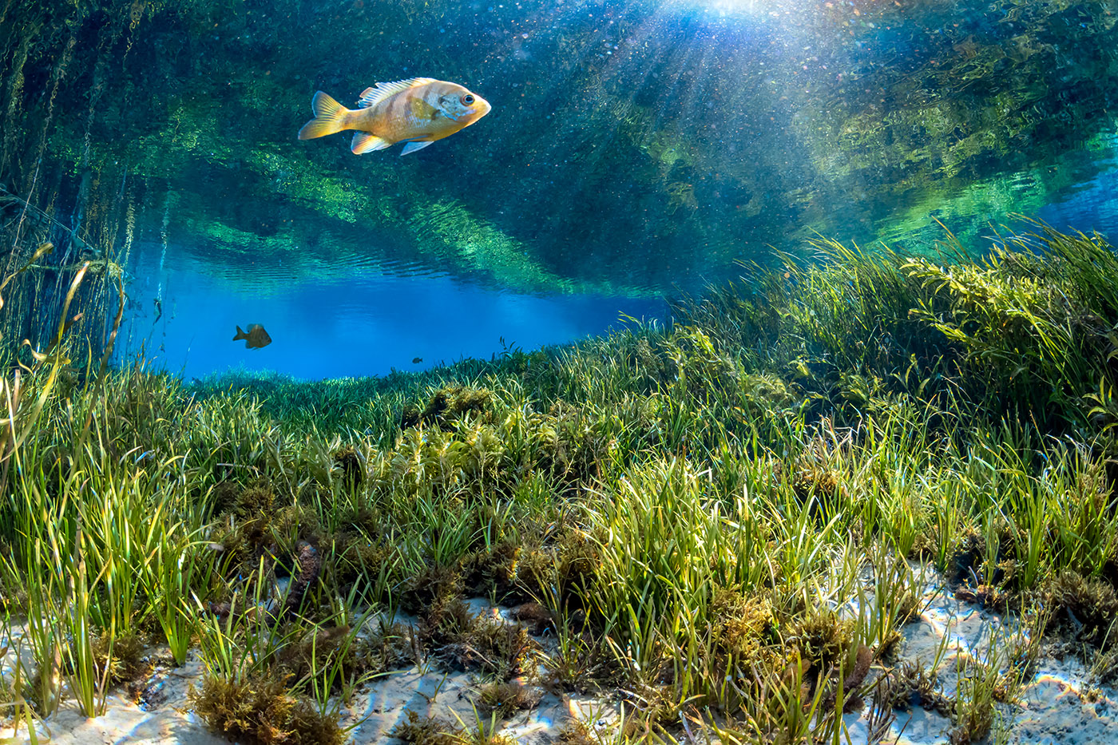
How can you help?
John Moran

Slide 36

We need petition gatherers.
We need 900,000 signed and approved petitions by Nov. 30, 2023.

Slide 37
We need petition gatherers.
Florida Supreme Court review by April 22nd , 2023.
Notes:
“You should have people gathering petitions at our local farmer’s market? Do you have people?”
“I hope I’m looking at them.” I said.

Slide 38
Cape Coral Arts and
Crafts Festival
January 2023
1,614 petitions
Notes:
Amendment sells itself

Slide 39
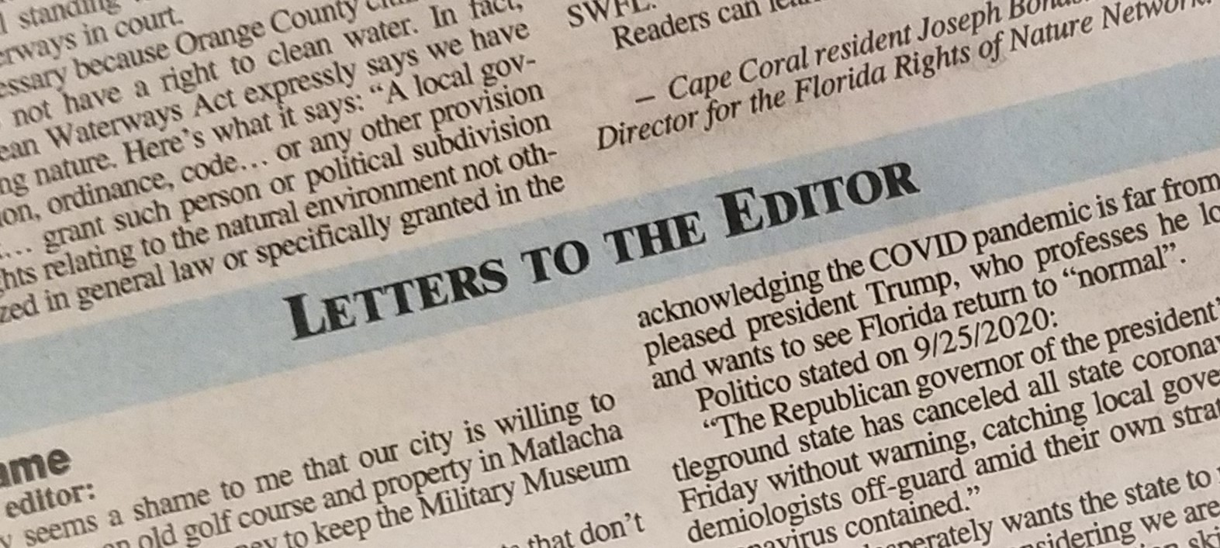
writers

Slide 40

and social media mavens

Slide 41
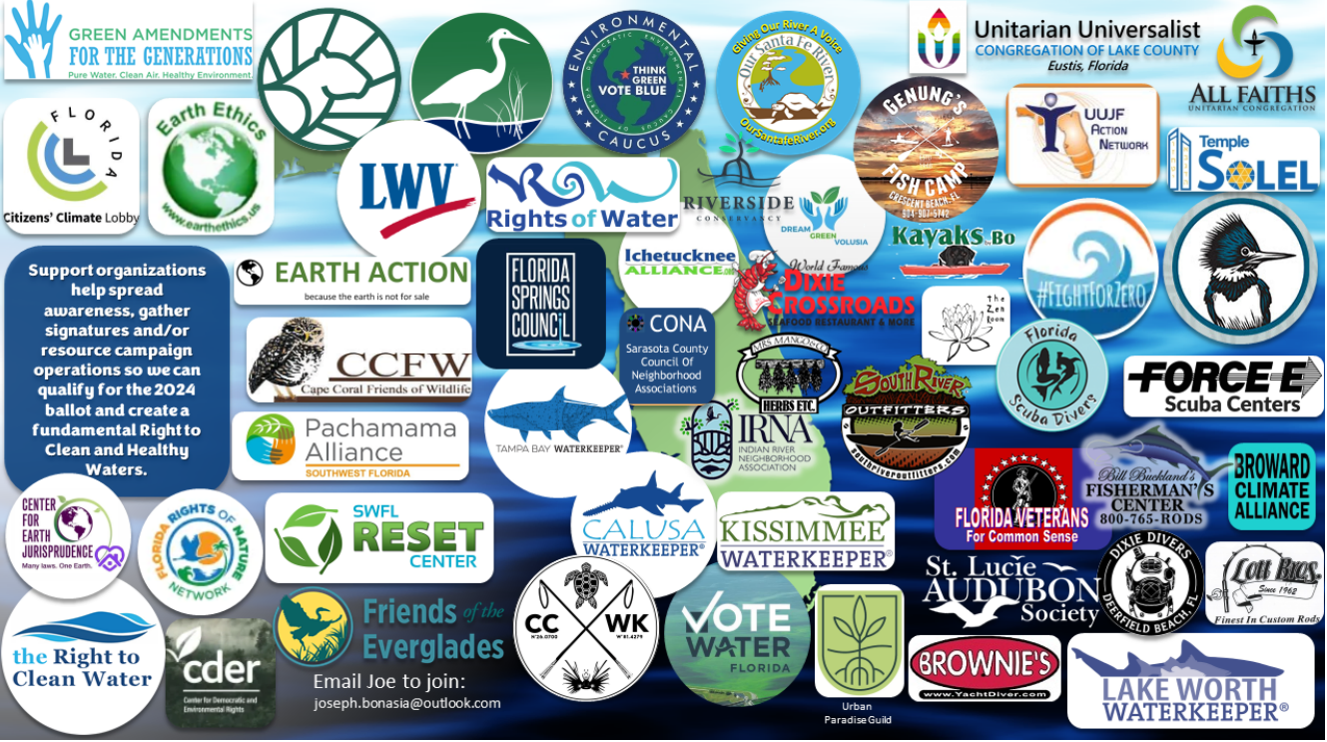
Florida League of Women Voters VoteWater.org Friends of the Everglades Waterkeepers
Florida Wildlife Federation Florida Springs Council UU Justice Florida Action Network …

Slide 42

FloridaRightToCleanWater.org
jbonasia@hotmail.com
Notes:
Even as I am recording this, our legislature wants to pass laws that favor special interests and weaken local water quality actions
Go
Make a donation
Register to become a volunteer
Get others to do the same

